Slide 1
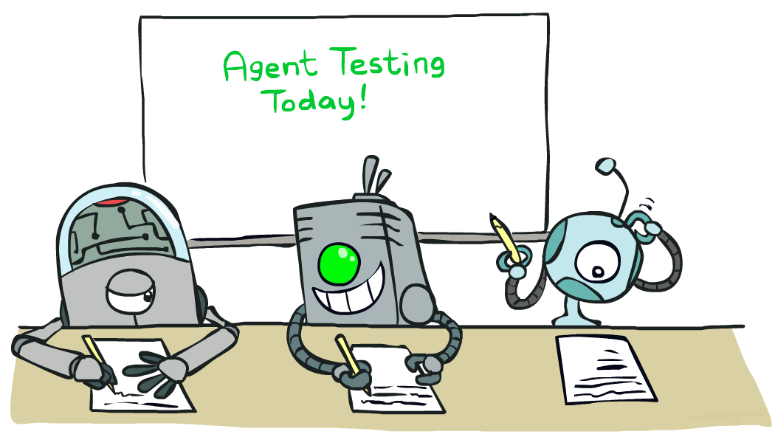

CS 188: Artificial Intelligence
Naïve Bayes
Spring 2023
[These slides were created by Dan Klein and Pieter Abbeel for CS188 Intro to AI at UC Berkeley. All CS188 materials are available at http://ai.berkeley.edu.]
Notes:
Please retain proper attribution, including the reference to ai.berkeley.edu. Thanks!

Slide 2
Machine Learning
Up until now: how use a model to make optimal decisions
Machine learning: how to acquire a model from data / experience
Learning parameters (e.g. probabilities)
Learning structure (e.g. BN graphs)
Learning hidden concepts (e.g. clustering, neural nets)
Today: model-based classification with Naive Bayes

Slide 3
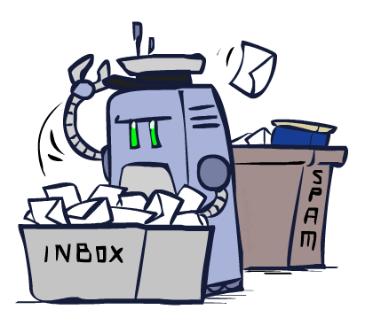
Classification

Slide 4
Classification and Machine Learning
Dataset: each data point, x, is associated with some label (aka class), y
Goal of classification: given inputs x, write an algorithm to predict labels y
Workflow of classification process:
Input is provided to you
Extract features from the input: attributes of the input that characterize each x and hopefully help with classification
Run some machine learning algorithm on the features: today, Naïve Bayes
Output a predicted label y
Feature extraction
Machine learning
x (input)
Features (attributes of x)
y (predicted output)
Notes:
Notes (Apr 2023, PK):
On this slide, we haven’t told you how to devise any algorithms yet. We’re just telling you what you want to design as an end goal.
Today, we’re just going to focus on the machine learning part of this workflow. We’ll talk about feature extraction (and how neural nets actually automate that process) next week.

Slide 5
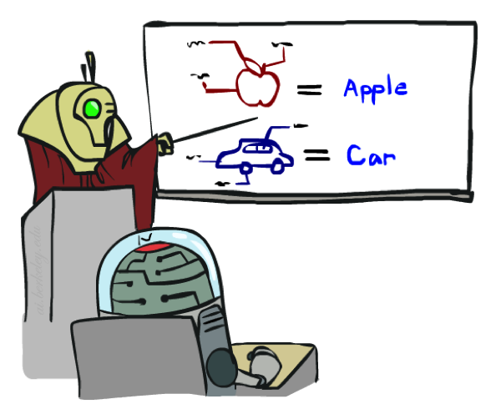
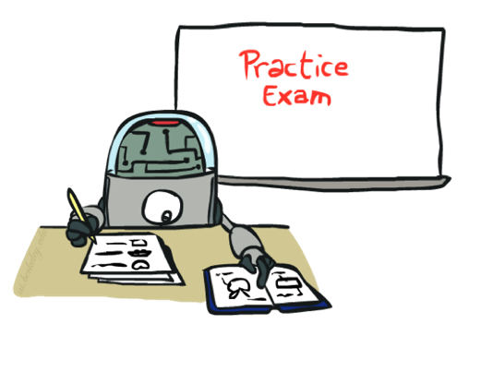
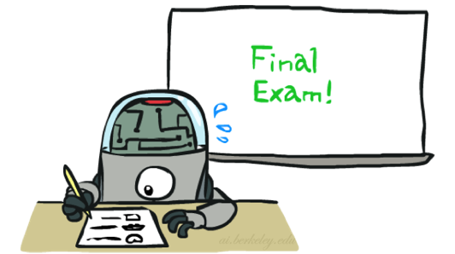
Training and Machine Learning
Big idea: ML algorithms learn patterns between features and labels from data
You don’t have to reason about the data yourself
You’re given training data: lots of example datapoints and their actual labels
Training: Learn patterns from labeled data, and periodically test how well you’re doing
Eventually, use your algorithm to predict labels for unlabeled data
Notes:
Notes (Apr 2023, PK):
If you really wanted, you could write an algorithm that predicts labels from features using your own expert knowledge of the problem (e.g. you might think really hard about which features indicate spam and which features indicate ham, and for each input, hand-craft some equation that combines the features into a prediction). But this won’t generalize to other problems, and it doesn’t take advantage of the fact that we often have data that we can automatically extract patterns from.
Usually, the data comes in the form of training data, which might be hand-labeled. We won’t talk today about where this data comes from, but know that collecting and cleaning big datasets is a huge part of ML as well.

Slide 6
Example: Spam Filter
Input: an email
Output: spam/ham
Setup:
Get a large collection of example emails, each labeled “spam” or “ham”
Note: someone has to hand label all this data!
Want to learn to predict labels of new, future emails
Features: The attributes used to make the ham / spam decision
Words: FREE!
Text Patterns: $dd, CAPS
Non-text: SenderInContacts, WidelyBroadcast
…
Dear Sir.
First, I must solicit your confidence in this transaction, this is by virture of its nature as being utterly confidencial and top secret. …
TO BE REMOVED FROM FUTURE MAILINGS, SIMPLY REPLY TO THIS MESSAGE AND PUT "REMOVE" IN THE SUBJECT.
99 MILLION EMAIL ADDRESSES
FOR ONLY $99
Ok, Iknow this is blatantly OT but I'm beginning to go insane. Had an old Dell Dimension XPS sitting in the corner and decided to put it to use, I know it was working pre being stuck in the corner, but when I plugged it in, hit the power nothing happened.

Slide 7




Example: Digit Recognition
Input: images / pixel grids
Output: a digit 0-9
Setup:
Get a large collection of example images, each labeled with a digit
Note: someone has to hand label all this data!
Want to learn to predict labels of new, future digit images
Features: The attributes used to make the digit decision
Pixels: (6,8)=ON
Shape Patterns: NumComponents, AspectRatio, NumLoops
…
Features are increasingly induced rather than crafted
0
1
2
1
??

Slide 8
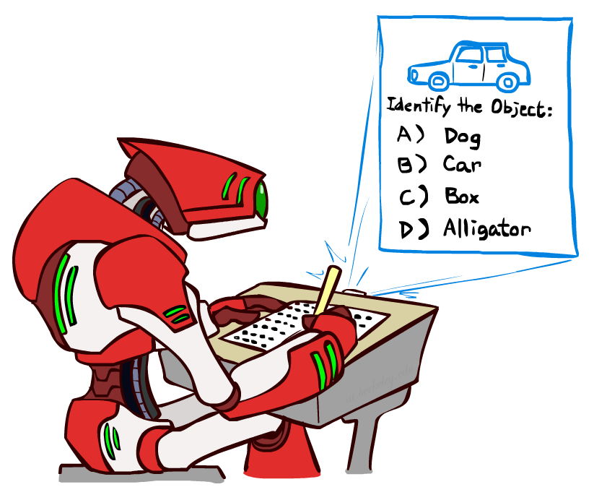
Other Classification Tasks
Classification: given inputs x, predict labels (classes) y
Examples:
Medical diagnosis (input: symptoms,
classes: diseases)
Fraud detection (input: account activity,
classes: fraud / no fraud)
Automatic essay grading (input: document,
classes: grades)
Customer service email routing
Review sentiment
Language ID
… many more
Classification is an important commercial technology!

Slide 9
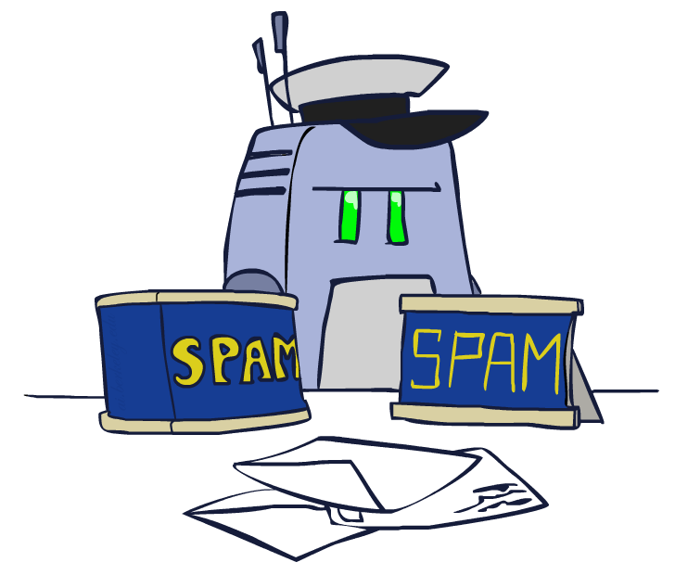
Model-Based Classification

Slide 10
Model-Based Classification
Model-based approach
Build a model (e.g. Bayes’ net) where both the output label and input features are random variables
Instantiate any observed features
Query for the distribution of the label conditioned on the features
Challenges
What structure should the BN have?
How should we learn its parameters?

Slide 11

Naïve Bayes Model
Random variables in this Bayes’ net:
Y = The label
F₁, F₂, …, F_{n} = The n features
Probability tables in this Bayes’ net:
P(Y) = Probability of each label occurring, given no information about the features. Sometimes called the prior.
P(F_{i}|Y) = One table per feature. Probability distribution over a feature, given the label.
Y
F₁
F₂
F_{n}

Slide 12
Naïve Bayes Model
To perform training:
Use the training dataset to estimate the probability tables.
Estimate P(Y) = how often does each label occur?
Estimate P(F_{i}|Y) = how does the label affect the feature?
To perform classification:
Instantiate all features. You know the input features, so they’re your evidence.
Query for P(Y|f₁, f₂, …, f_{n}). Probability of label, given all the input features. Use an inference algorithm (e.g. variable elimination) to compute this.
Y
F₁
F₂
F_{n}

Slide 13
Example: Naïve Bayes for Spam Filter
Step 1: Select a ML algorithm. We choose to model the problem with Naïve Bayes.
Step 2: Choose features to use.
Y: The label (spam or ham)
Y | P(Y)
ham | ?
spam | ?
Y
F₁: A feature (do I know the sender?)
F₁ | Y | P(F₁|Y)
yes | ham | ?
no | ham | ?
yes | spam | ?
no | spam | ?
F₂: Another feature (# of occurrences of FREE)
F₂ | Y | P(F₂|Y)
0 | ham | ?
1 | ham | ?
2 | ham | ?
0 | spam | ?
1 | spam | ?
2 | spam | ?
F₁
F₂
Notes:
Notes (Apr 2023, PK):
How did I draw this Bayes’ net structure? It’s the model I’ve chosen (and it turns out to be pretty effective). I haven’t done any learning, training or classification yet; I just chose a ML algorithm to use.

Slide 14
Example: Naïve Bayes for Spam Filter
Step 3: Training: Use training data to fill in the probability tables.
F₂: # of occurrences of FREE
F₂ | Y | P(F₂|Y)
0 | ham | 0.5
1 | ham | 0.5
2 | ham | 0.0
0 | spam | 0.25
1 | spam | 0.50
2 | spam | 0.25
Training Data
# | Email Text | Label
1 | Attached is my portfolio. | ham
2 | Are you free for a meeting tomorrow? | ham
3 | Free unlimited credit cards!!!! | spam
4 | Mail $10,000 check to this address | spam
5 | Sign up now for 1 free Bitcoin | spam
6 | Free money free money | spam
F₂: # of occurrences of FREE
F₂ | Y | P(F₂|Y)
0 | ham
1 | ham
2 | ham
0 | spam
1 | spam
2 | spam
Row 4: P(F₂=0 | Y=spam) = 0.25 because 1 out of 4 spam emails contains “free” 0 times.
Row 5: P(F₂=1 | Y=spam) = 0.50 because 2 out of 4 spam emails contains “free” 1 time.
Row 6: P(F₂=2 | Y=spam) = 0.25 because 1 out of 4 spam emails contains “free” 2 times.

Slide 15
Example: Naïve Bayes for Spam Filter
Model trained on a larger dataset:
Y: The label (spam or ham)
Y | P(Y)
ham | 0.6
spam | 0.4
Y
F₁: A feature (do I know the sender?)
F₁ | Y | P(F₁|Y)
yes | ham | 0.7
no | ham | 0.3
yes | spam | 0.1
no | spam | 0.9
F₂: Another feature (# of occurrences of FREE)
F₂ | Y | P(F₂|Y)
0 | ham | 0.85
1 | ham | 0.07
2 | ham | 0.08
0 | spam | 0.75
1 | spam | 0.12
2 | spam | 0.13
F₁
F₂
Notes:
Notes (Apr 2023, PK):
What makes this ML is the fact that we didn’t have to reason for ourselves how the label affects these features. We didn’t have to manually deduce that most spam emails come from unknown senders; instead, the training process automatically learned this deduction by computing statistics on the data (rows 3-4 of F1).

Slide 16
Example: Naïve Bayes for Spam Filter
Step 4: Classification
Suppose you want to label this email from a known sender: “Free food in Soda 430 today”
Step 4.1: Feature extraction:
F₁ = yes, known sender
F₂ = 1 occurrence of “free”
Y
F₁
F₂

Slide 17
Example: Naïve Bayes for Spam Filter
Step 4.2: Inference
Instantiate features (evidence):
F₁ = yes
F₂ = 1
Compute joint probabilities:
P(Y = spam, F₁ = yes, F₂ = 1) = P(Y = spam) P(F₁ = yes | spam) P(F₂ = 1 | spam) = 0.4 * 0.1 * 0.12 = 0.0048
P(Y = ham, F₁ = yes, F₂ = 1) = P(Y = ham) P(F₁ = yes | ham) P(F₂ = 1 | ham) = 0.6 * 0.7 * 0.07 = 0.0294
Normalize:
P(Y = spam | F₁ = yes, F₂ = 1) = 0.0048 / (0.0048+0.0294) = 0.14
P(Y = ham | F₁ = yes, F₂ = 1) = 0.0294 / (0.0048+0.0294) = 0.86
Classification result:
14% chance the email is spam. 86% chance it’s ham.
Or, if you don’t need probabilities, note that 0.0294 > 0.0048 and guess ham.
Y: The label (spam or ham)
Y | P(Y)
ham | 0.6
spam | 0.4
F₁: do I know the sender?
F₁ | Y | P(F₁|Y)
yes | ham | 0.7
no | ham | 0.3
yes | spam | 0.1
no | spam | 0.9
F₂: # of occurrences of FREE
F₂ | Y | P(F₂|Y)
0 | ham | 0.85
1 | ham | 0.07
2 | ham | 0.08
0 | spam | 0.75
1 | spam | 0.12
2 | spam | 0.13

Slide 18

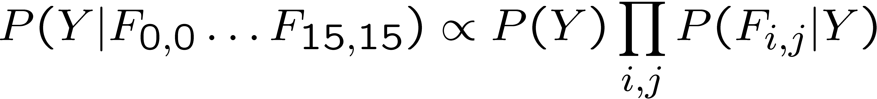
Naïve Bayes for Digits
Simple digit recognition version:
One feature (variable) F_{ij} for each grid position <i,j>
Feature values are on / off, based on whether intensity
is more or less than 0.5 in underlying image
Each input maps to a feature vector, e.g.
Here: lots of features, each is binary valued
Naïve Bayes model:
What do we need to learn?
Y
F₁
F₂
F_{n}

Slide 19
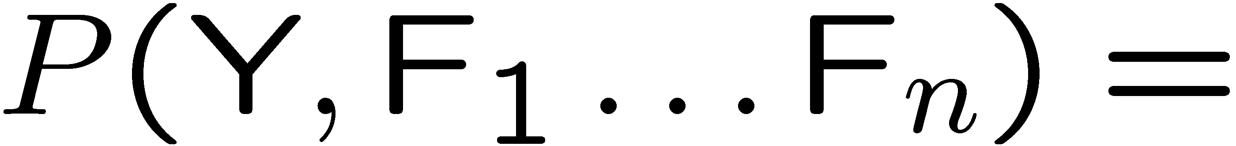
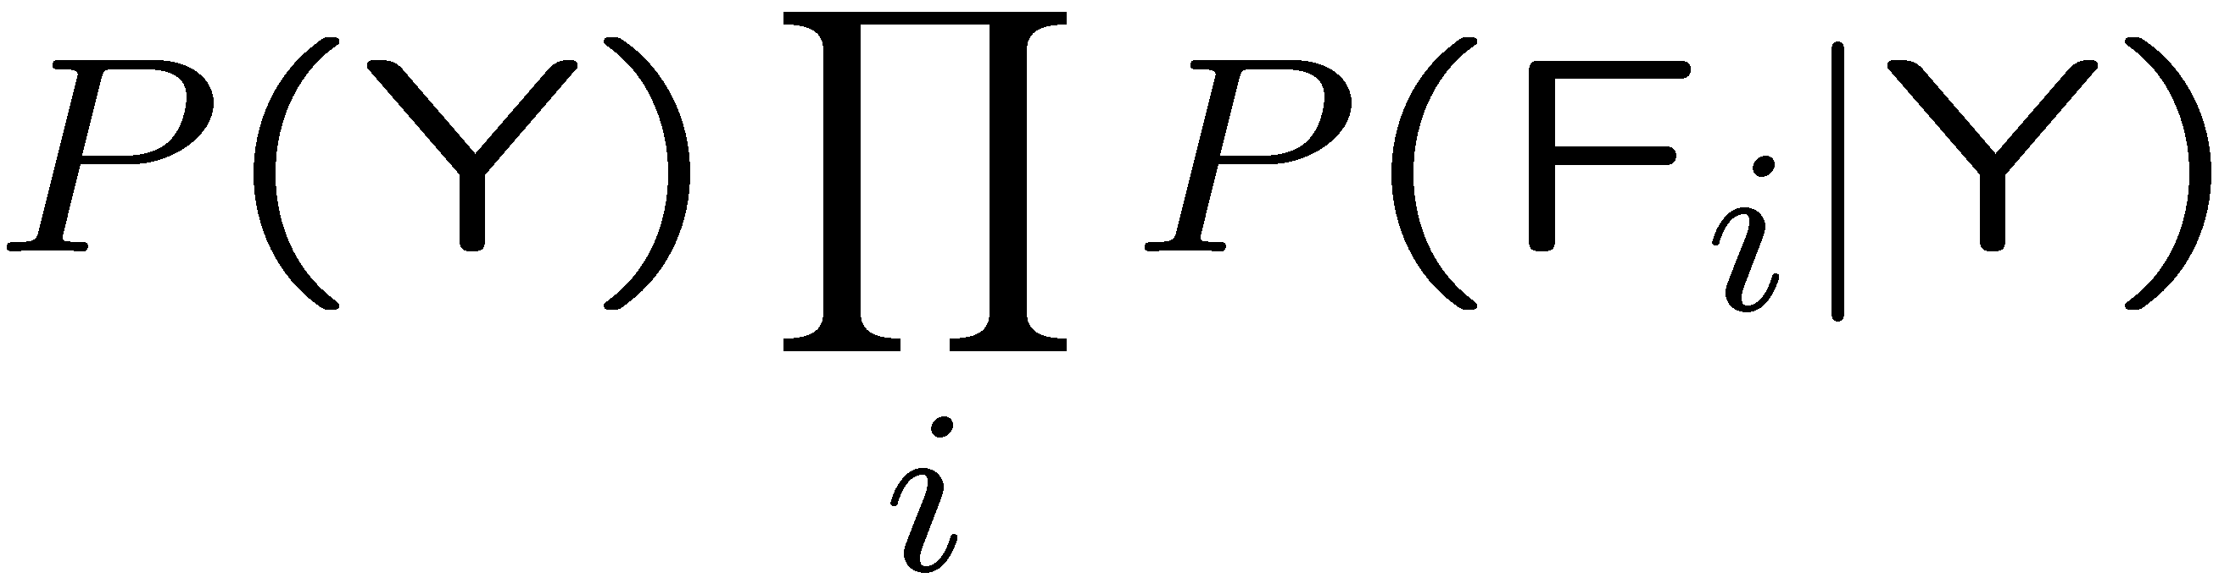
General Naïve Bayes
Naïve Bayes assumes that all features are independent effects of the label
A general Naive Bayes model:
We only have to specify how each feature depends on the class
Total number of parameters is linear in n
Model is very simplistic, but often works anyway
Y
|Y| parameters
F₁
F₂
F_{n}
|Y| x |F|^{n} values
n x |F| x |Y| parameters

Slide 20
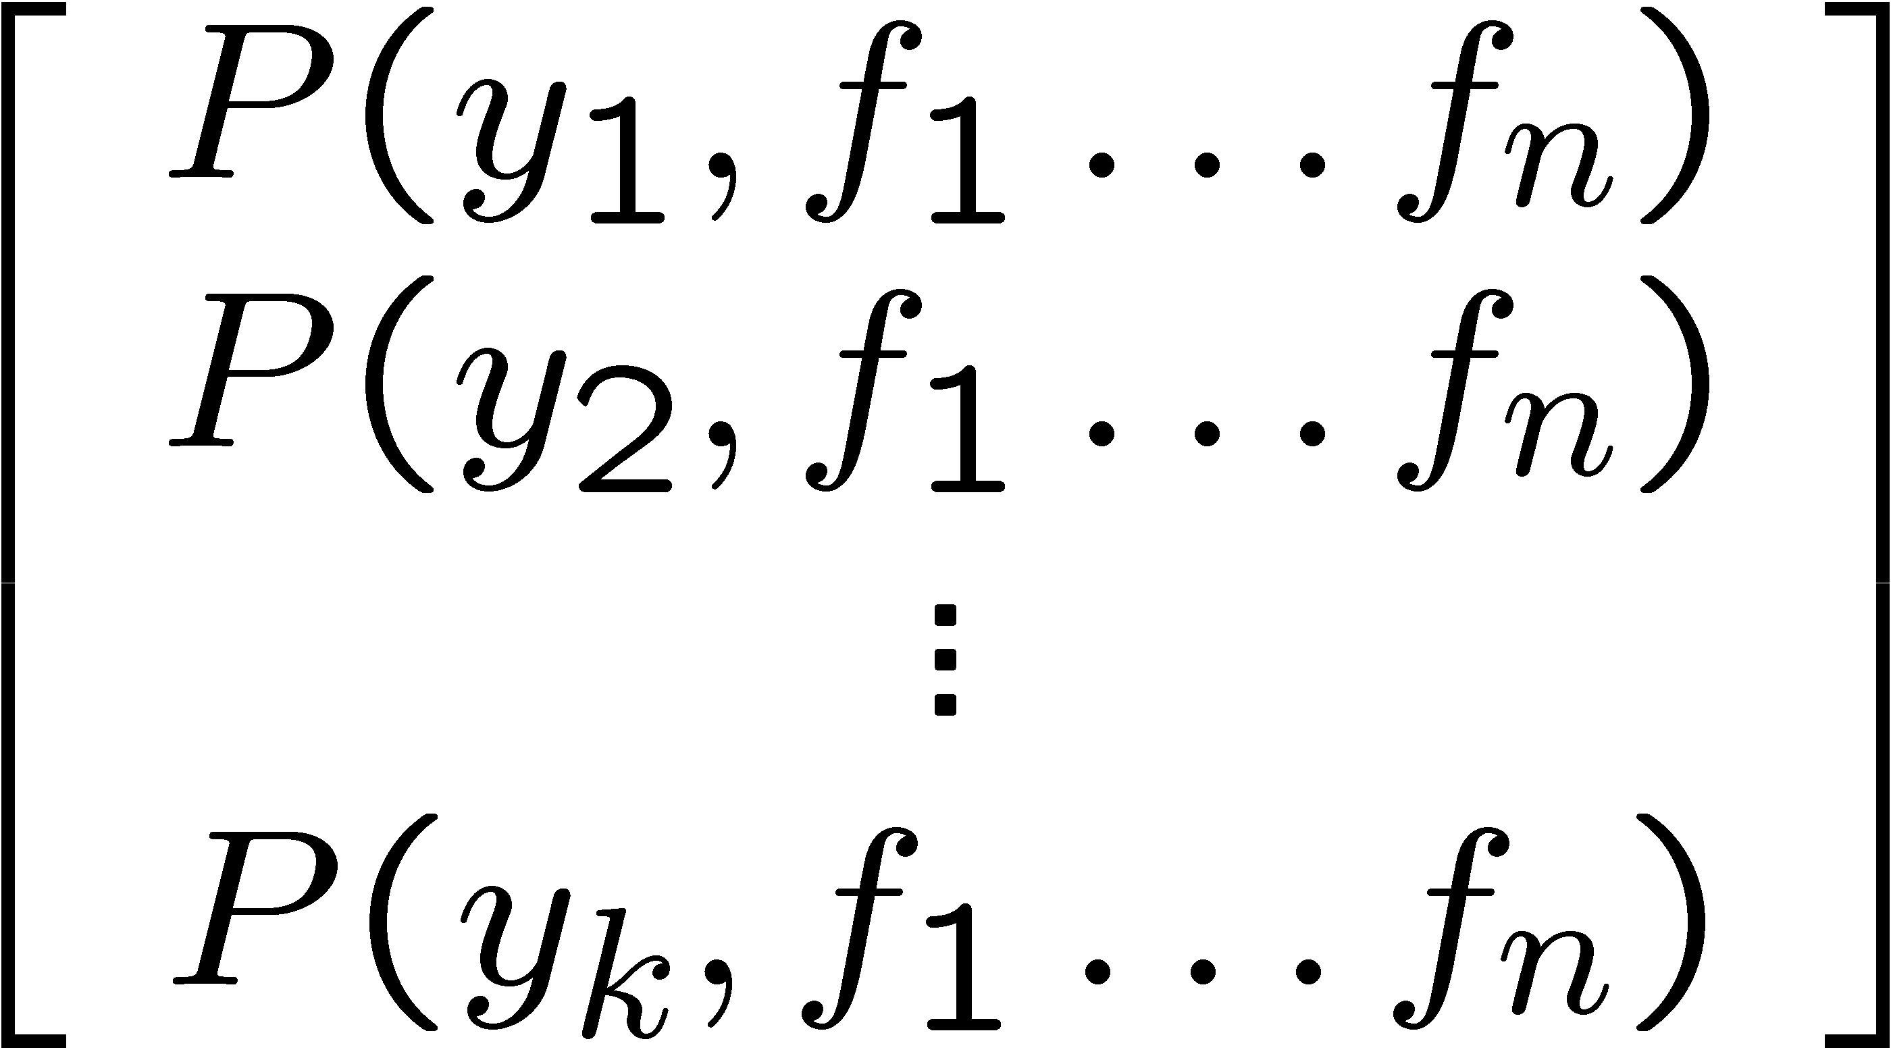
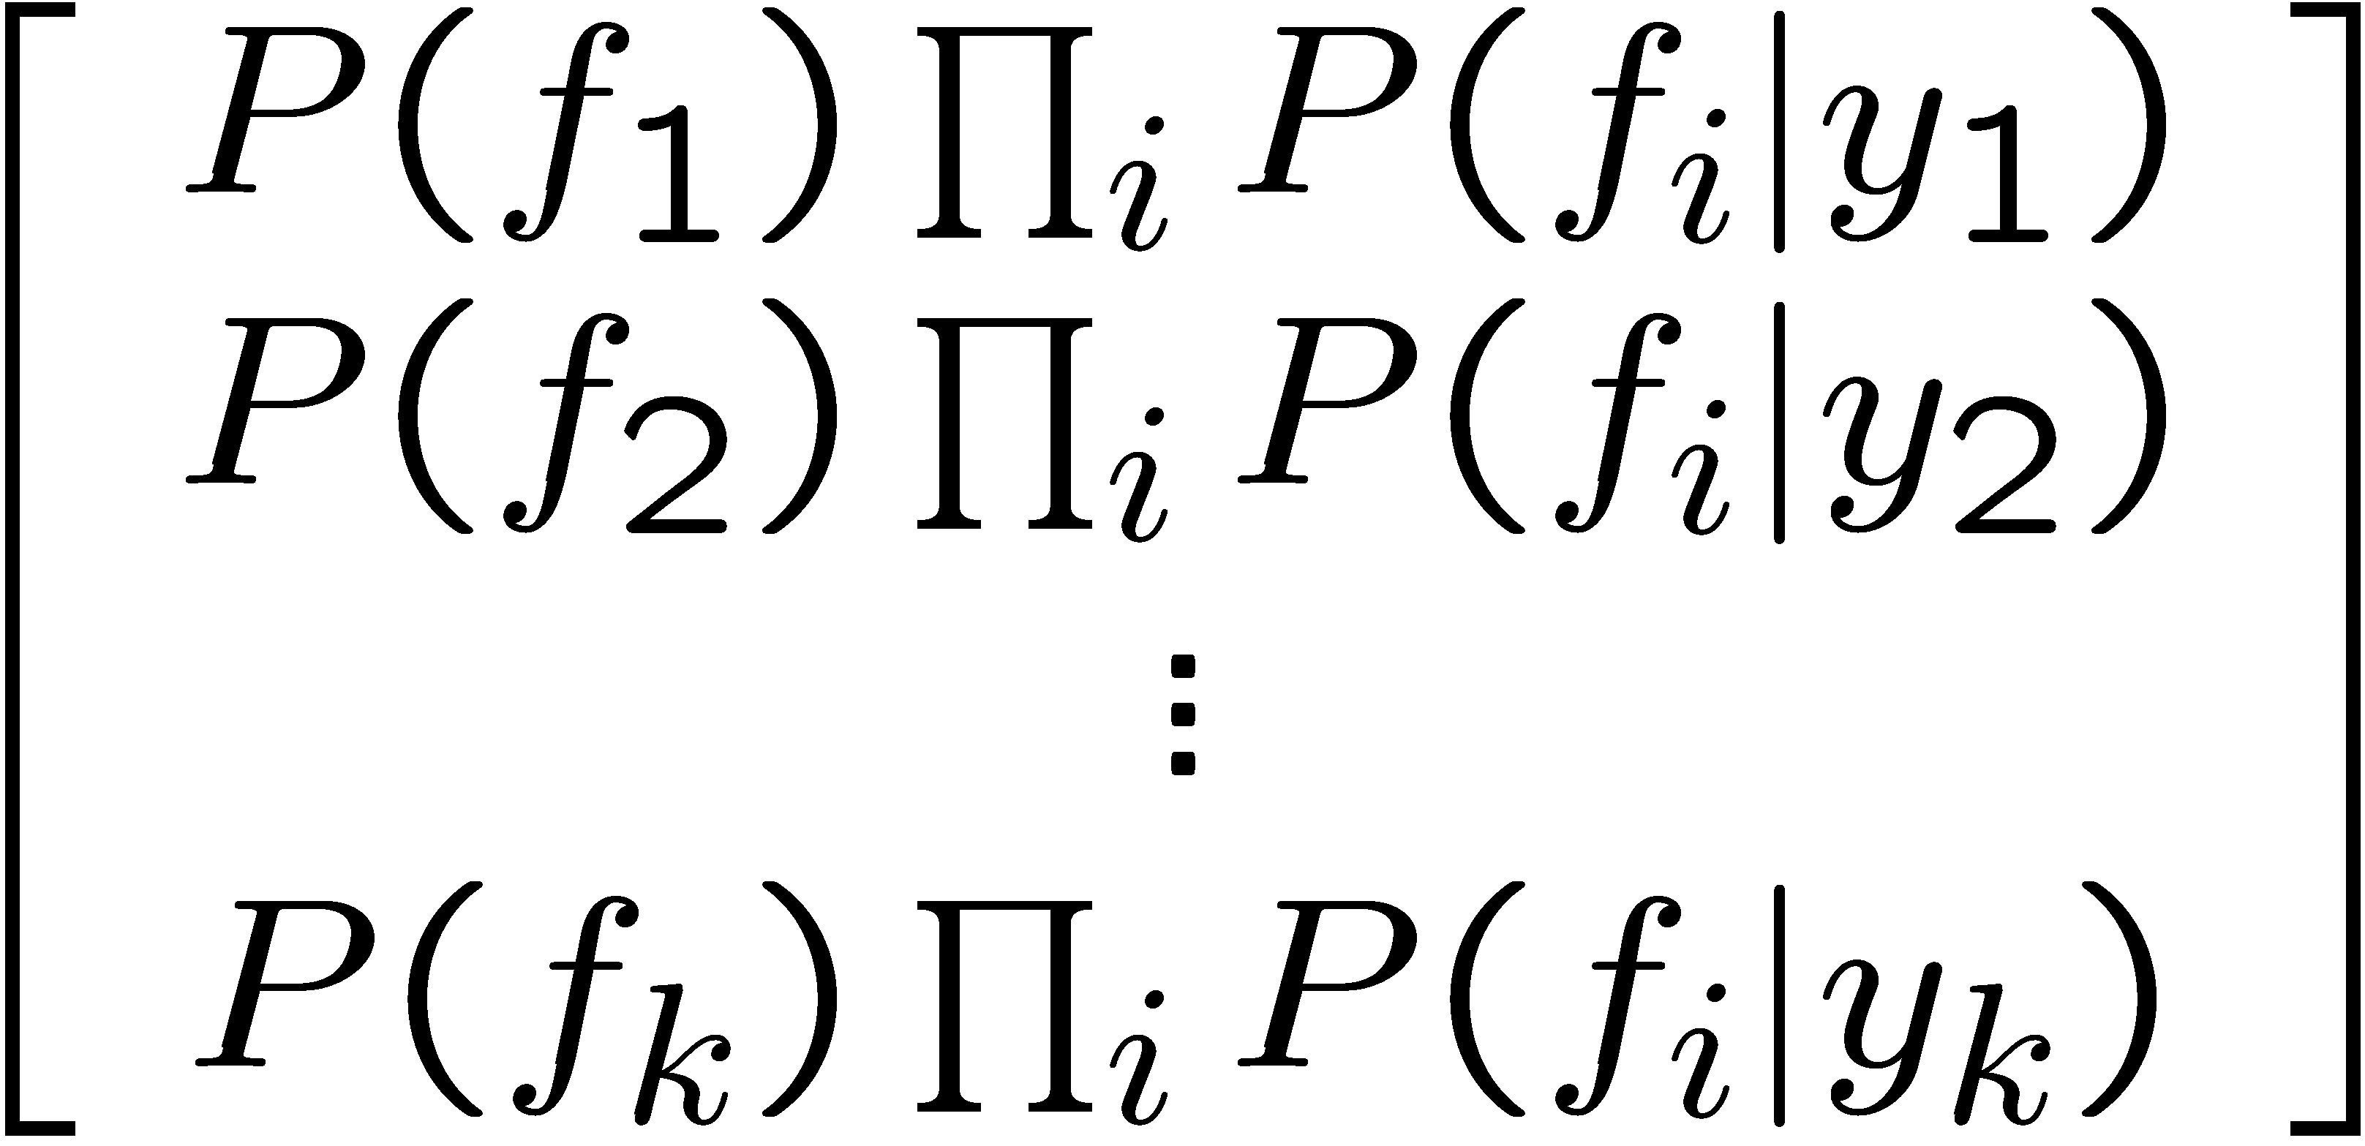
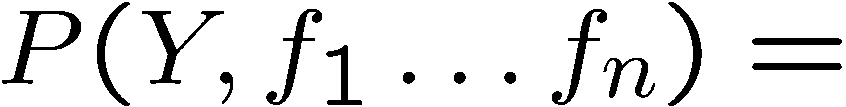
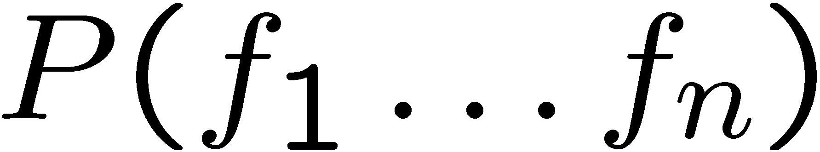
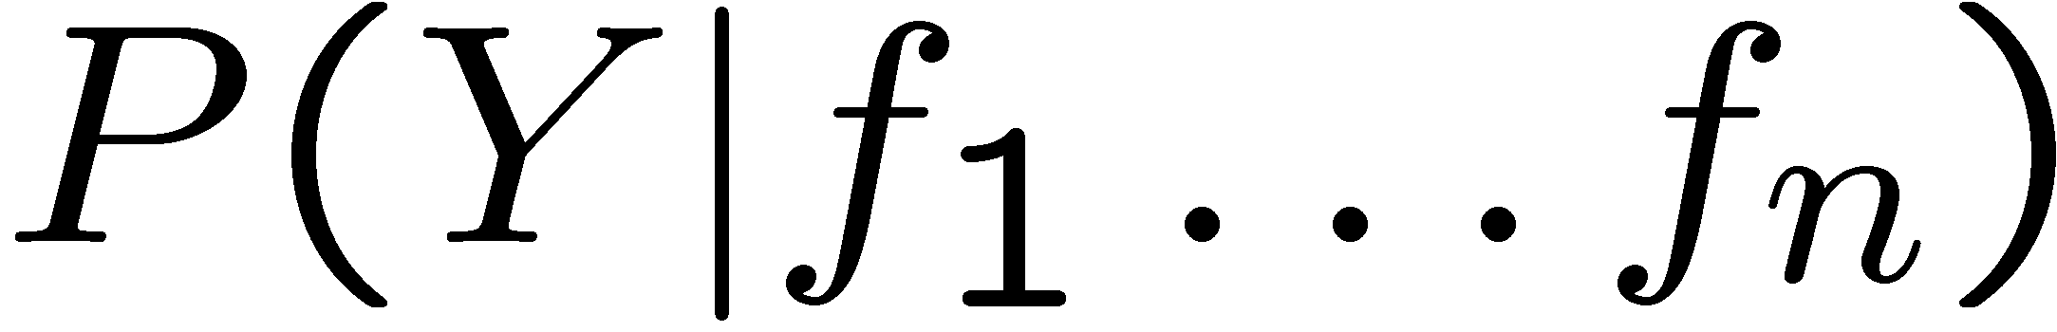
Inference for Naïve Bayes
Goal: compute posterior distribution over label variable Y
Step 1: get joint probability of label and evidence for each label
Step 2: sum to get probability of evidence
Step 3: normalize by dividing Step 1 by Step 2
+

Slide 21
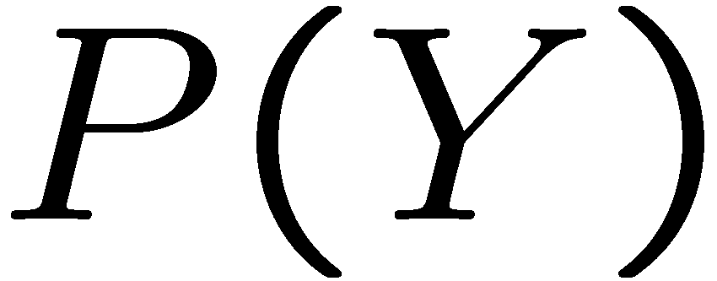


Example: Conditional Probabilities
1 | 0.1
2 | 0.1
3 | 0.1
4 | 0.1
5 | 0.1
6 | 0.1
7 | 0.1
8 | 0.1
9 | 0.1
0 | 0.1
1 | 0.01
2 | 0.05
3 | 0.05
4 | 0.30
5 | 0.80
6 | 0.90
7 | 0.05
8 | 0.60
9 | 0.50
0 | 0.80
1 | 0.05
2 | 0.01
3 | 0.90
4 | 0.80
5 | 0.90
6 | 0.90
7 | 0.25
8 | 0.85
9 | 0.60
0 | 0.80

Slide 22
A Spam Filter
Naïve Bayes spam filter
Data:
Collection of emails, labeled spam or ham
Note: someone has to hand label all this data!
Split into training, held-out, test sets
Classifiers
Learn on the training set
(Tune it on a held-out set)
Test it on new emails
Dear Sir.
First, I must solicit your confidence in this transaction, this is by virture of its nature as being utterly confidencial and top secret. …
TO BE REMOVED FROM FUTURE MAILINGS, SIMPLY REPLY TO THIS MESSAGE AND PUT "REMOVE" IN THE SUBJECT.
99 MILLION EMAIL ADDRESSES
FOR ONLY $99
Ok, Iknow this is blatantly OT but I'm beginning to go insane. Had an old Dell Dimension XPS sitting in the corner and decided to put it to use, I know it was working pre being stuck in the corner, but when I plugged it in, hit the power nothing happened.

Slide 23
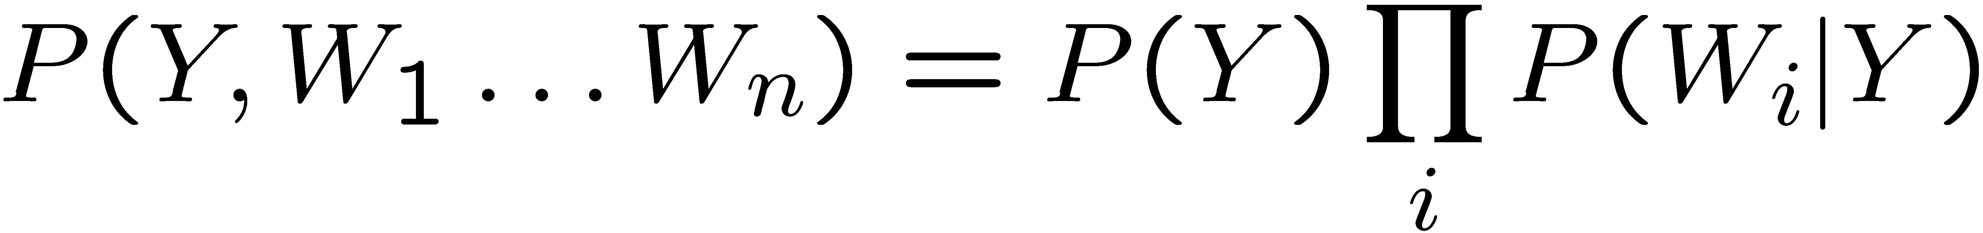
Naïve Bayes for Text
Bag-of-words Naïve Bayes:
Features: W_{i} is the word at position i
As before: predict label conditioned on feature variables (spam vs. ham)
As before: assume features are conditionally independent given label
New: each W_{i} is identically distributed
Generative model:
“Tied” distributions and bag-of-words
Usually, each variable gets its own conditional probability distribution P(F|Y)
In a bag-of-words model
Each position is identically distributed
All positions share the same conditional probs P(W|Y)
Why make this assumption?
Called “bag-of-words” because model is insensitive to word order or reordering
Word at position i, not i^{th} word in the dictionary!

Slide 24

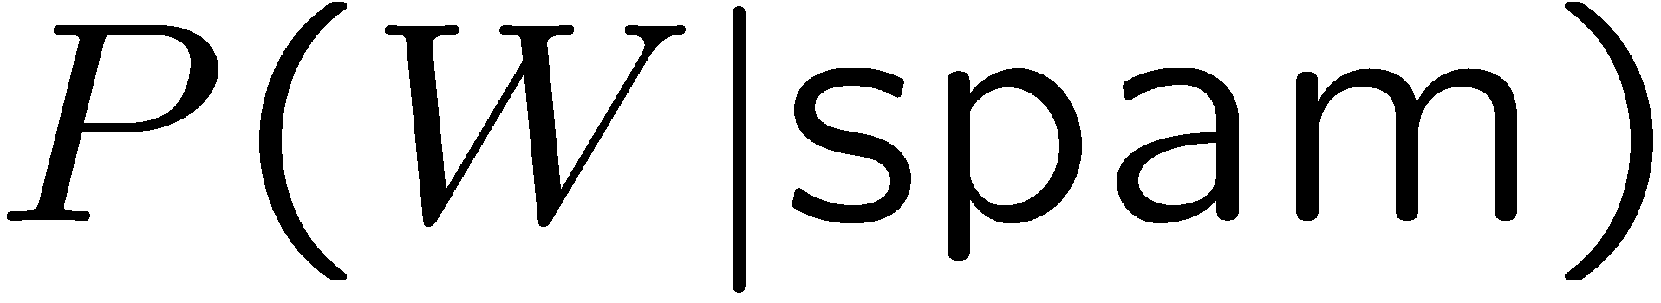
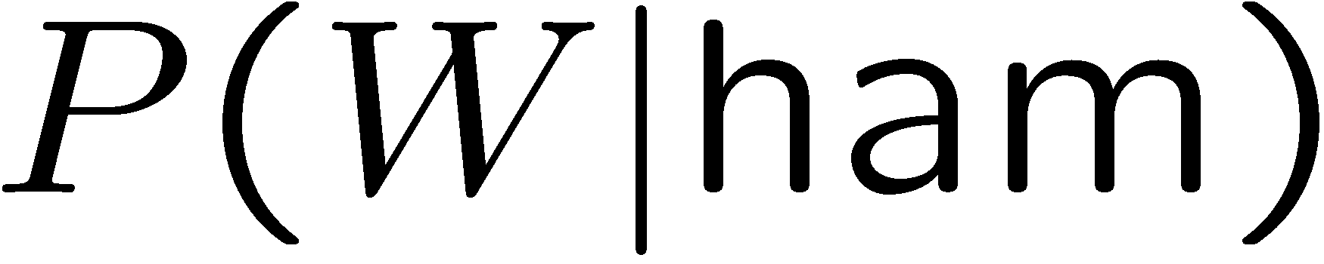
Example: Spam Filtering
Model:
What are the parameters?
Where do these tables come from?
ham : 0.66
spam: 0.33
the : 0.0156
to : 0.0153
and : 0.0115
of : 0.0095
you : 0.0093
a : 0.0086
with: 0.0080
from: 0.0075
...
the : 0.0210
to : 0.0133
of : 0.0119
2002: 0.0110
with: 0.0108
from: 0.0107
and : 0.0105
a : 0.0100
...

Slide 25
Spam Example
Word | P(w|spam) | P(w|ham) | Tot Spam | Tot Ham
(prior) | 0.33333 | 0.66666 | -1.1 | -0.4
Gary | 0.00002 | 0.00021 | -11.8 | -8.9
would | 0.00069 | 0.00084 | -19.1 | -16.0
you | 0.00881 | 0.00304 | -23.8 | -21.8
like | 0.00086 | 0.00083 | -30.9 | -28.9
to | 0.01517 | 0.01339 | -35.1 | -33.2
lose | 0.00008 | 0.00002 | -44.5 | -44.0
weight | 0.00016 | 0.00002 | -53.3 | -55.0
while | 0.00027 | 0.00027 | -61.5 | -63.2
you | 0.00881 | 0.00304 | -66.2 | -69.0
sleep | 0.00006 | 0.00001 | -76.0 | -80.5
P(spam | w) = 98.9

Slide 26
General Naïve Bayes
What do we need in order to use Naïve Bayes?
Inference method
Start with a bunch of probabilities: P(Y) and the P(F_{i}|Y) tables
Use standard inference to compute P(Y|F₁…F_{n})
Nothing new here
Estimates of local conditional probability tables
P(Y), the prior over labels
P(F_{i}|Y) for each feature (evidence variable)
These probabilities are collectively called the parameters of the model and denoted by θ
Up until now, we assumed these appeared by magic, but they typically come from training data counts

Slide 27
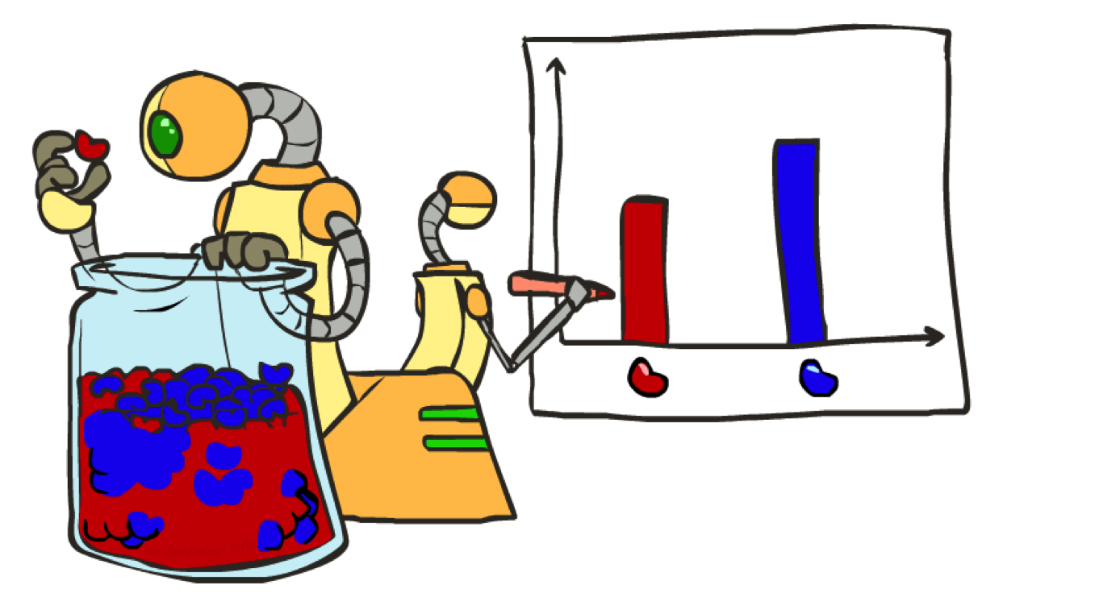
Parameter Estimation

Slide 28
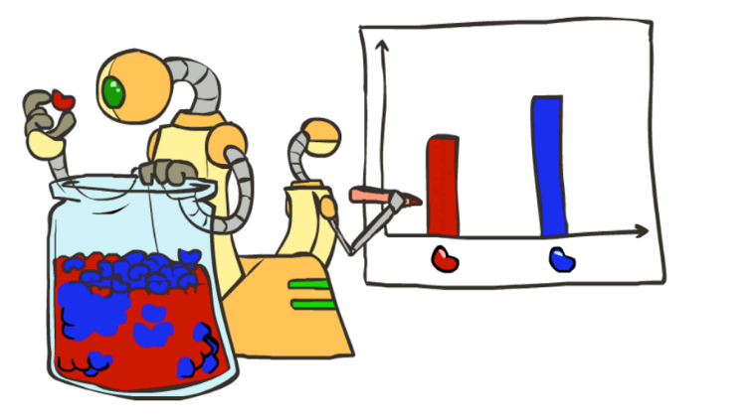
Parameter Estimation
Estimating the distribution of a random variable
Elicitation: ask a human (why is this hard?)
Empirically: use training data (learning!)
Example: The parameter θ is the true fraction of red beans in the jar. You don’t know θ but would like to estimate it.
Collecting training data: You randomly pull out 3 beans:
Estimating θ using counts, you guess 2/3 of beans in the jar are red.
Can we mathematically show that using counts is the “right” way to estimate θ?
r
b
b
b
r
r
b
b
b
r
r
b
b
b
b
r
r
b

Slide 29
Parameter Estimation with Maximum Likelihood
Can we mathematically show that using counts is the “right” way to estimate θ?
Maximum likelihood estimation: Choose the θ value that maximizes the probability of the observation
In other words, choose the θ value that maximizes P(observation | θ)
For our problem: P(observation | θ) = P(randomly selected 2 red and 1 blue | θ of beans are red) = P(red | θ) P(red | θ) P(blue | θ) = θ² (1- θ)
We want to compute: argmax θ² (1- θ) θ

Slide 30
Parameter Estimation with Maximum Likelihood
We want to compute: argmax θ² (1- θ) θ
Set derivative to 0, and solve!
Common issue: The likelihood (expression we’re maxing) is the product of a lot of probabilities. This can lead to complicated derivatives.
Solution: Maximize the log-likelihood instead. Useful fact: argmax f(θ) = argmax ln f(θ) θ θ

Slide 31
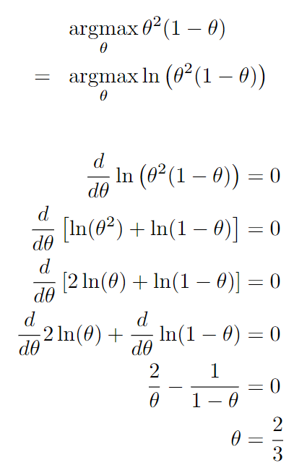
Parameter Estimation with Maximum Likelihood
Find θ that maximizes likelihood
Find θ that maximizes log-likelihood (will be the same θ)
Set derivative to 0
Logarithm rule: products become sums
Logarithm rule: exponentiation becomes multiplication
Now we can derive each term of the original product separately
Reminder: Derivative of ln(θ) is 1/θ
Use algebra to solve for θ. If we used arbitrary red and blue counts r and b instead of r=2 and b=1, we’d get θ = r / (r+b), the count estimate.
Notes:
\begin{align*}& \ \ \argmax_\theta \theta^2 (1-\theta) \\=& \ \ \argmax_\theta \ln\left(\theta^2 (1-\theta)\right)\end{align*}\begin{align*}\frac{d}{d\theta} \ln\left(\theta^2 (1-\theta)\right) &= 0 \\\frac{d}{d\theta} \left[ \ln(\theta^2) + \ln(1-\theta) \right] &= 0 \\\frac{d}{d\theta} \left[ 2\ln(\theta) + \ln(1-\theta) \right] &= 0 \\\frac{d}{d\theta} 2\ln(\theta) + \frac{d}{d\theta} \ln(1-\theta) &= 0 \\\frac{2}{\theta} - \frac{1}{1-\theta} &= 0 \\\theta &= \frac{2}{3}\end{align*}

Slide 32
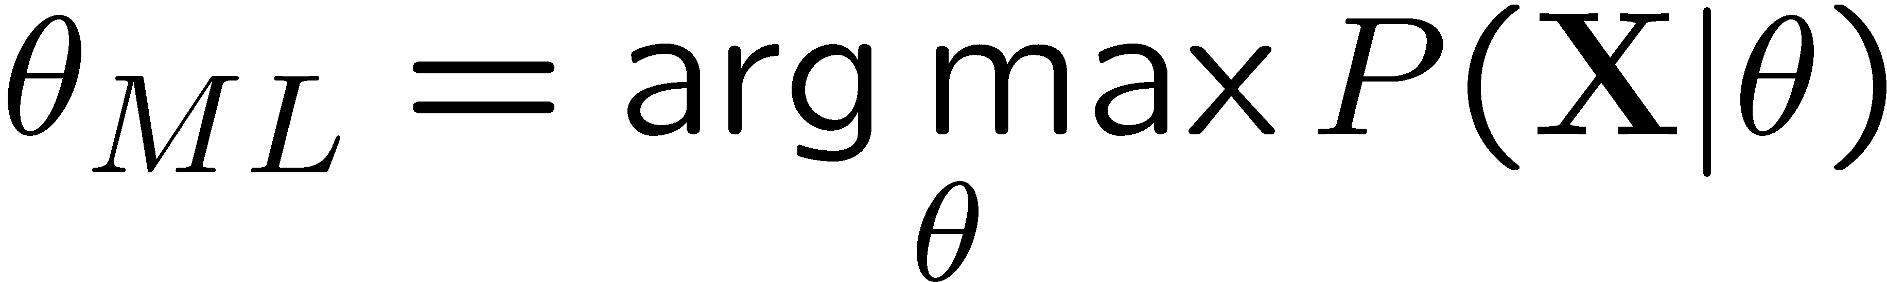
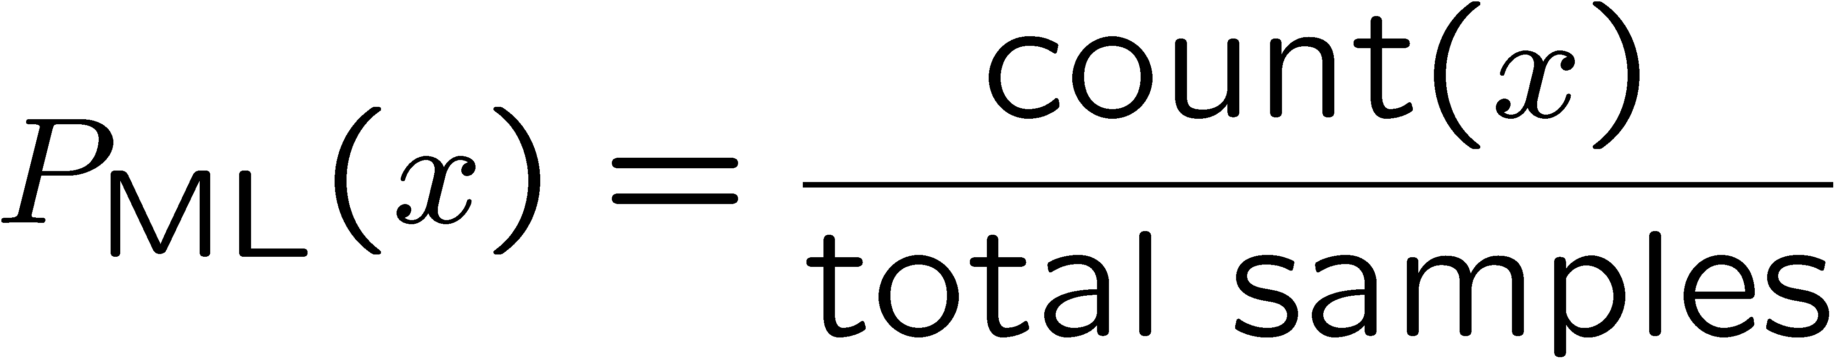
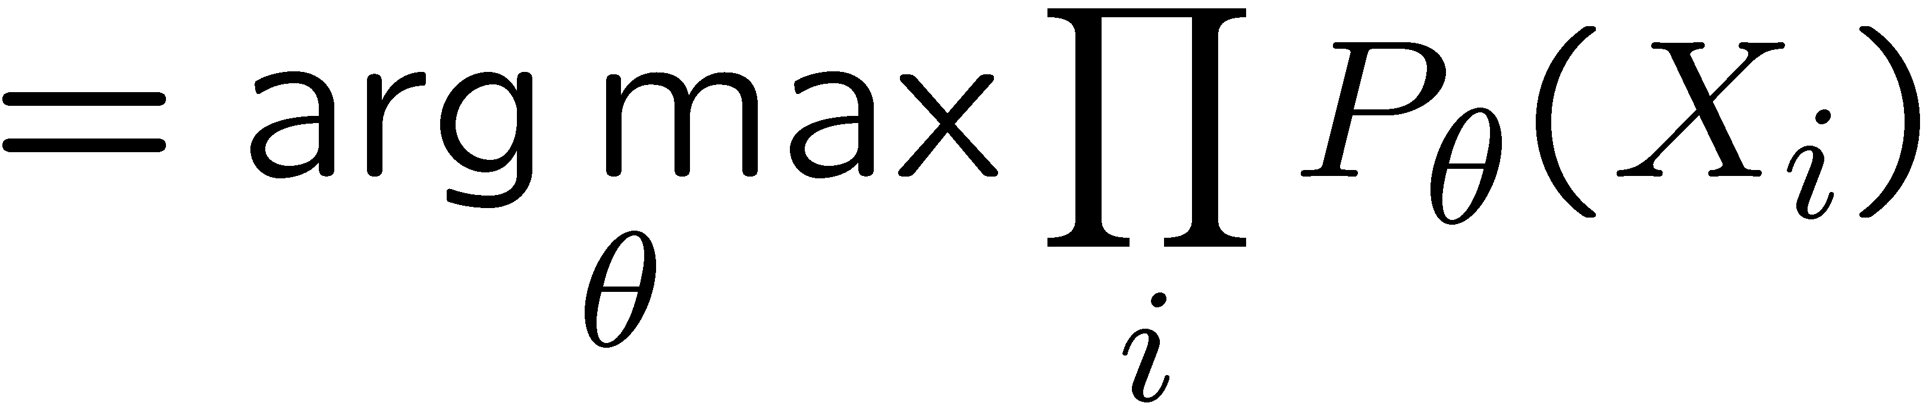
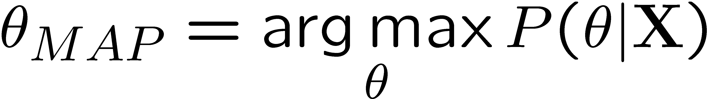
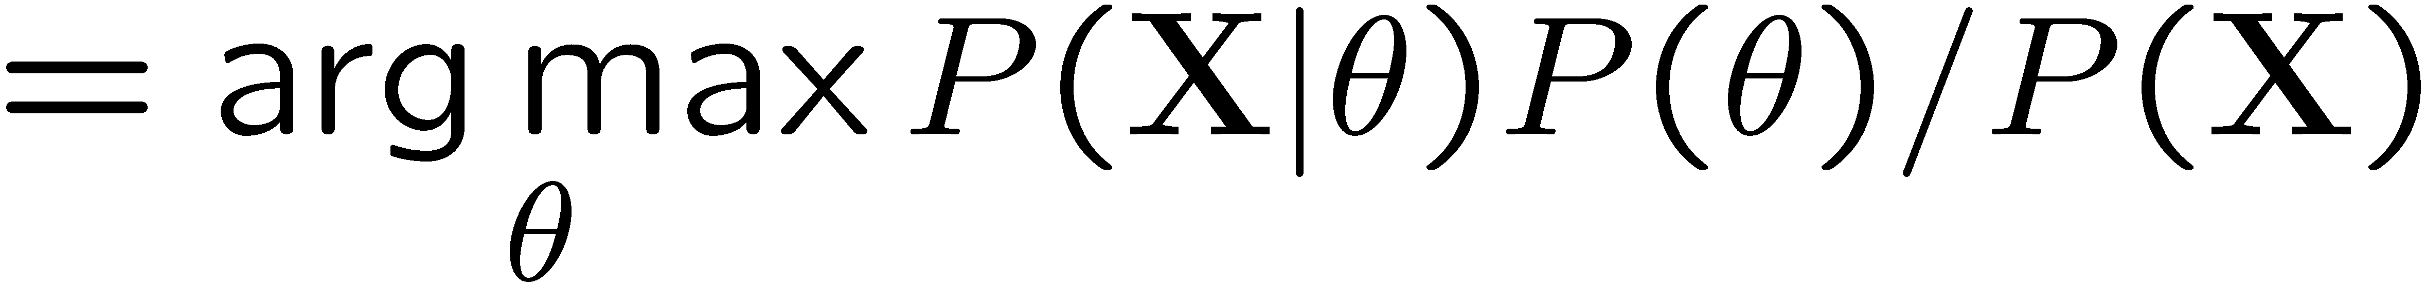
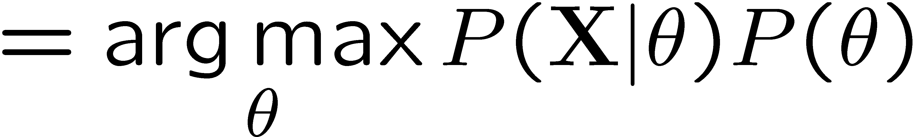
Maximum Likelihood?
Relative frequencies are the maximum likelihood estimates
Another option is to consider the most likely parameter value given the data
????

Slide 33
Parameter Estimation with Maximum Likelihood
How do we estimate the conditional probability tables?
Maximum Likelihood, which corresponds to counting
Need to be careful though … let’s see what can go wrong..

Slide 34

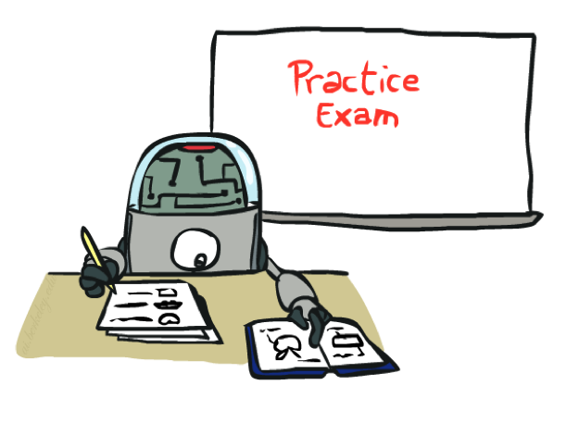
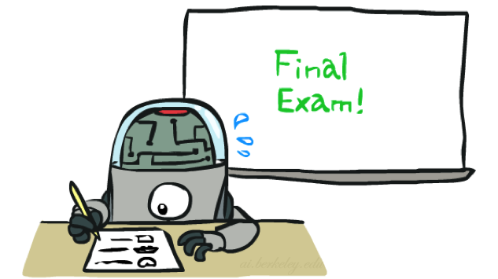
Training and Testing

Slide 35
Empirical Risk Minimization
Empirical risk minimization
Basic principle of machine learning
We want the model (classifier, etc) that does best on the true test distribution
Don’t know the true distribution so pick the best model on our actual training set
Finding “the best” model on the training set is phrased as an optimization problem
Main worry: overfitting to the training set
Better with more training data (less sampling variance, training more like test)
Better if we limit the complexity of our hypotheses (regularization and/or small hypothesis spaces)

Slide 36

Overfitting
30
25
20
Degree 15 polynomial
15
10
5
0
-5
-10
-15
0
2
4
6
8
10
12
14
16
18
20

Slide 37
Important Concepts
How do we check that we’re not overfitting during training?
Split training data into 3 different sets:
Training set
Held out set (more on this later)
Test set
Experimentation cycle
Learn parameters (e.g. model probabilities) on training set
Compute accuracy of test set
Very important: never “peek” at the test set!
Evaluation (many metrics possible, e.g. accuracy)
Accuracy: fraction of instances predicted correctly
Overfitting and generalization
Want a classifier which does well on test data
Overfitting: fitting the training data very closely, but not generalizing well
We’ll investigate overfitting and generalization formally in a few lectures
Training
Data
Held-Out
Data
Test
Data

Slide 38
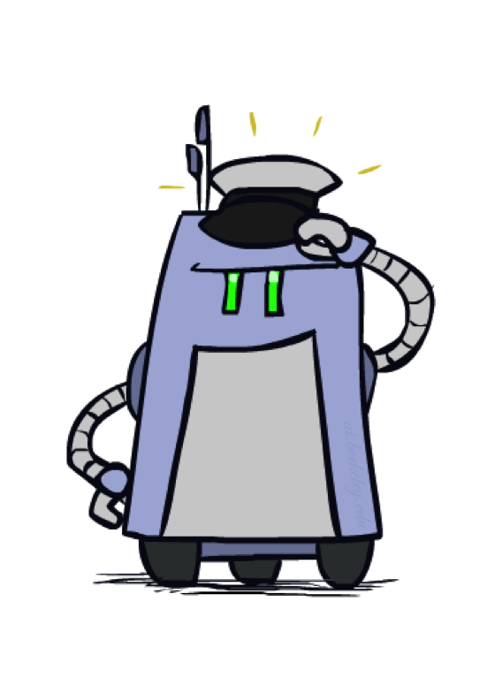

Generalization and Overfitting

Slide 39












Example: Overfitting
2 wins!!

Slide 40
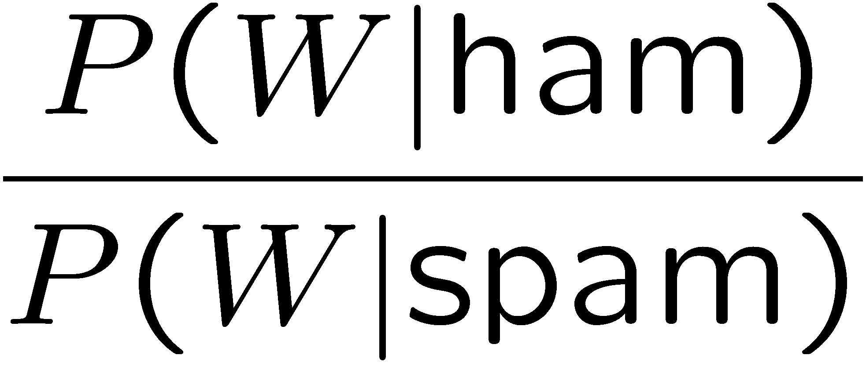
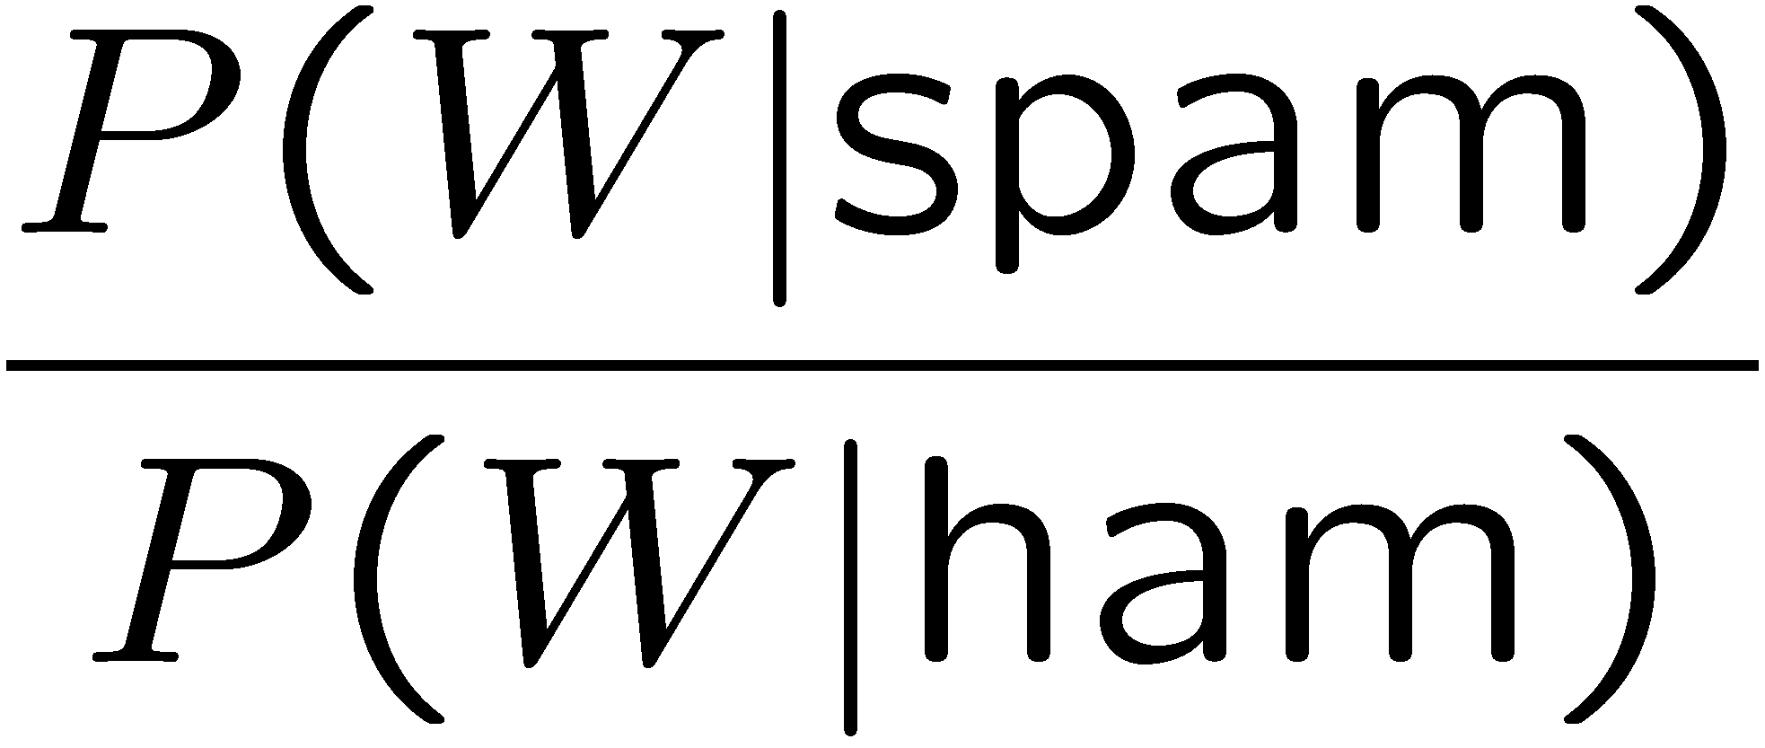
Example: Overfitting
Posteriors determined by relative probabilities (odds ratios):
south-west : inf
nation : inf
morally : inf
nicely : inf
extent : inf
seriously : inf
...
screens : inf
minute : inf
guaranteed : inf
$205.00 : inf
delivery : inf
signature : inf
...
What went wrong here?

Slide 41
Generalization and Overfitting
Relative frequency parameters will overfit the training data!
Just because we never saw a 3 with pixel (15,15) on during training doesn’t mean we won’t see it at test time
Unlikely that every occurrence of “minute” is 100% spam
Unlikely that every occurrence of “seriously” is 100% ham
What about all the words that don’t occur in the training set at all?
In general, we can’t go around giving unseen events zero probability
As an extreme case, imagine using the entire email as the only feature (e.g. document ID)
Would get the training data perfect (if deterministic labeling)
Wouldn’t generalize at all
Just making the bag-of-words assumption gives us some generalization, but isn’t enough
To generalize better: we need to smooth or regularize the estimates

Slide 42
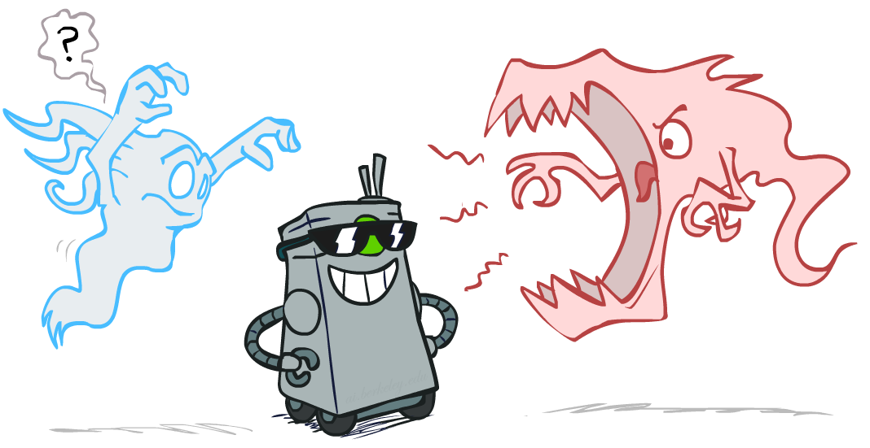
Smoothing

Slide 43

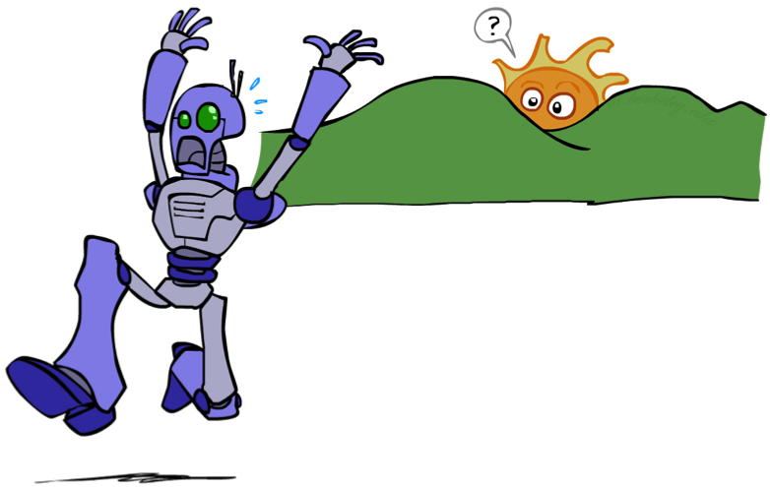
Unseen Events

Slide 44
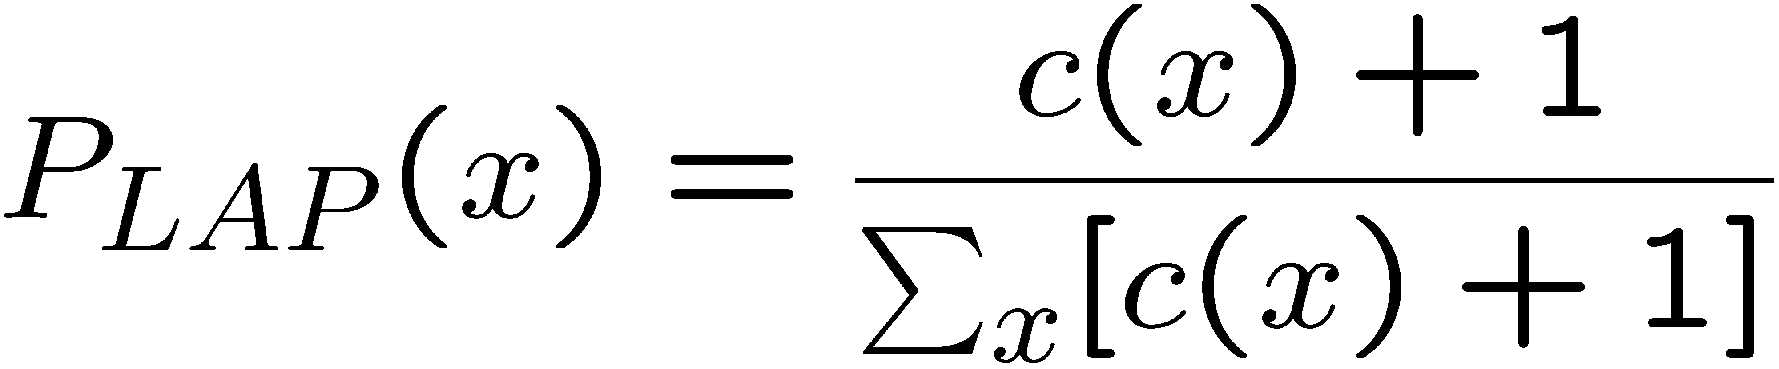
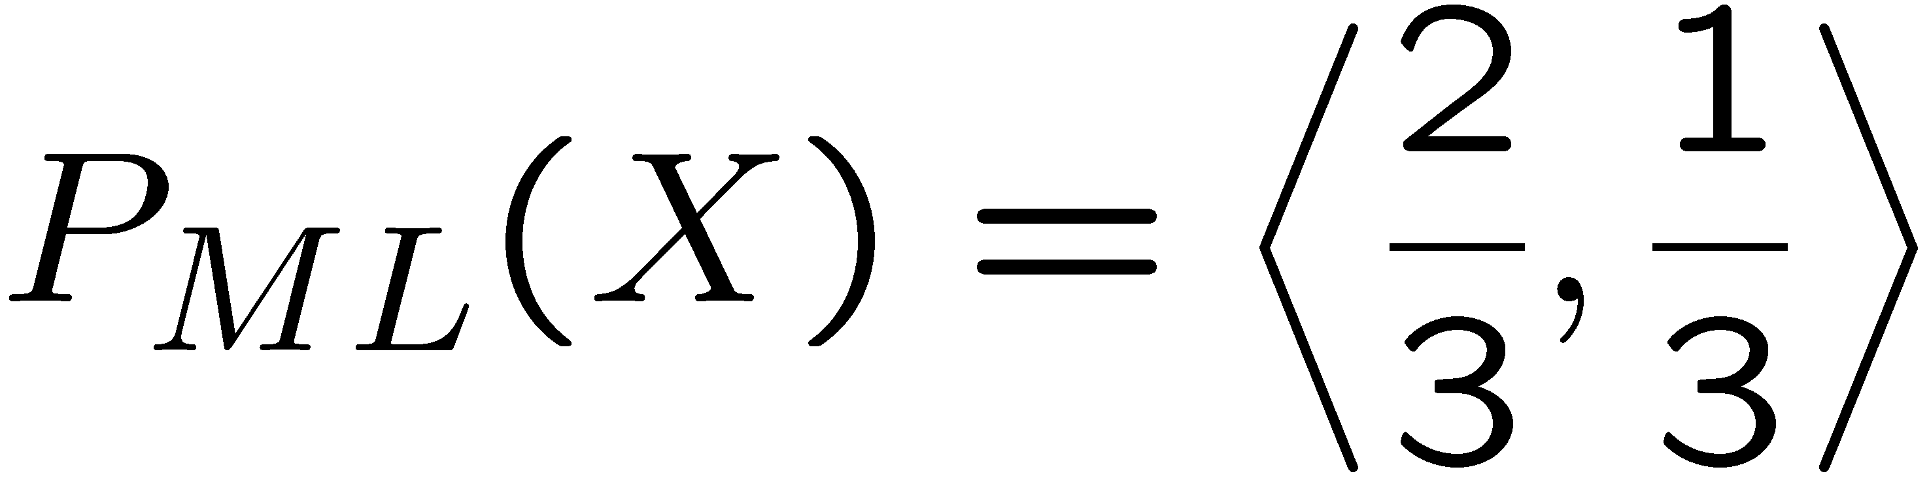
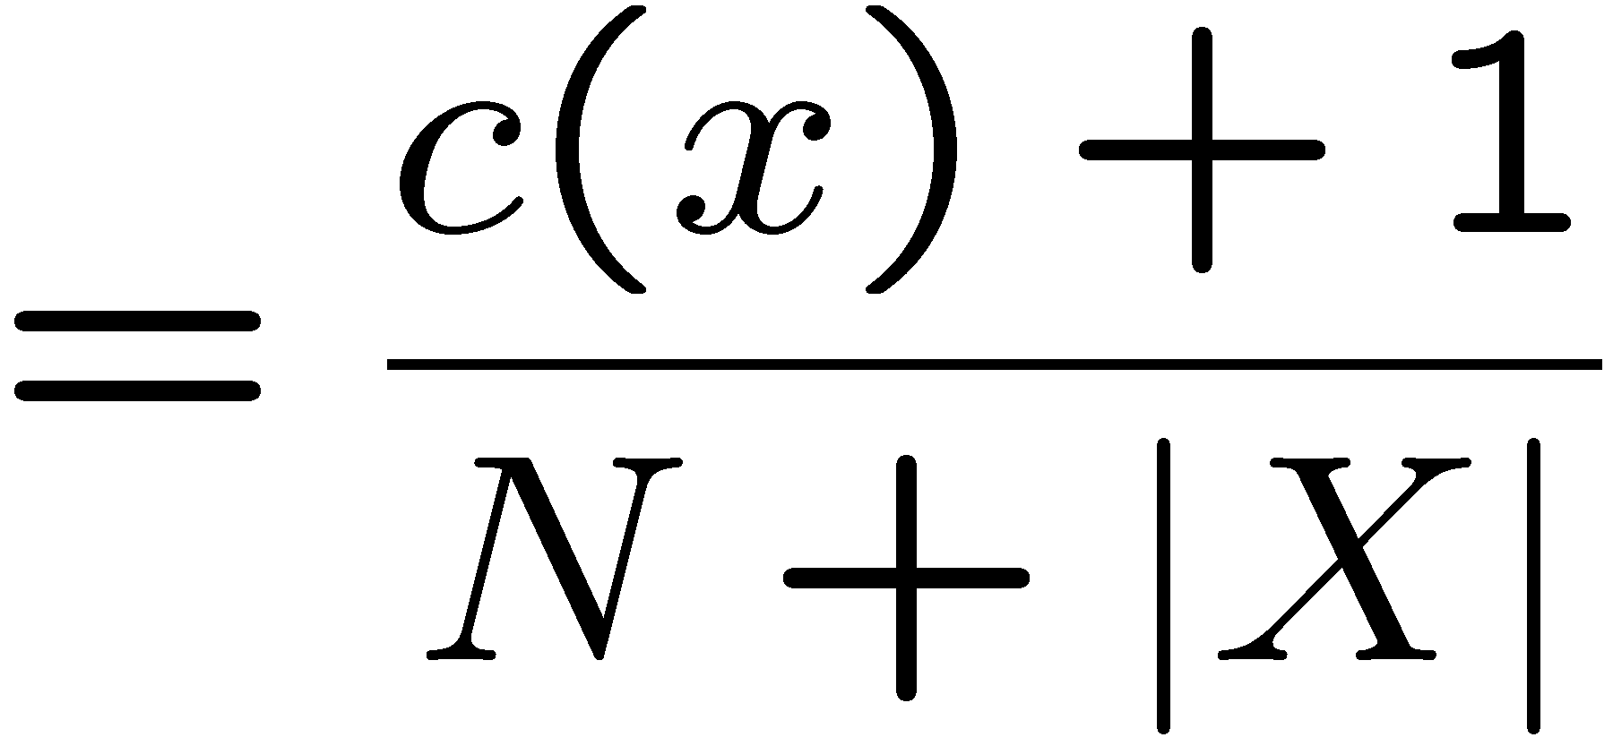
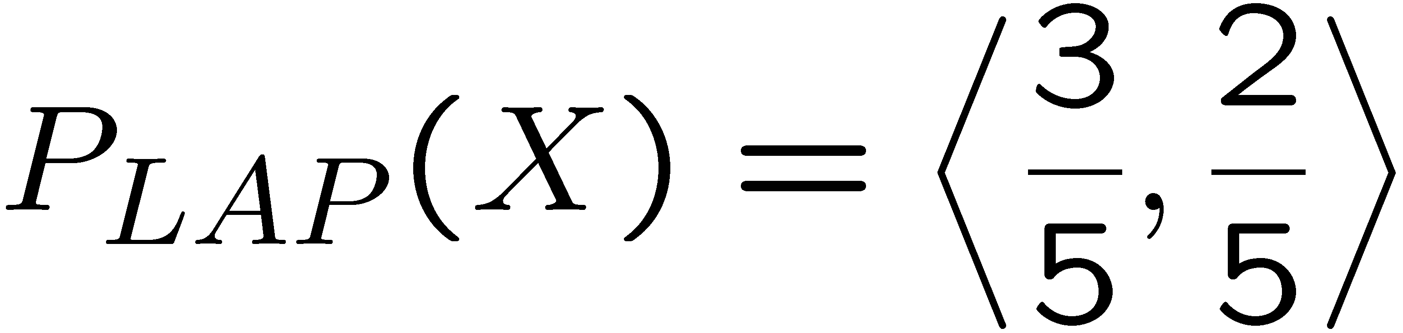
Laplace Smoothing
Laplace’s estimate:
Pretend you saw every outcome once more than you actually did
Can derive this estimate with Dirichlet priors (see cs281a)
r
r
b

Slide 45
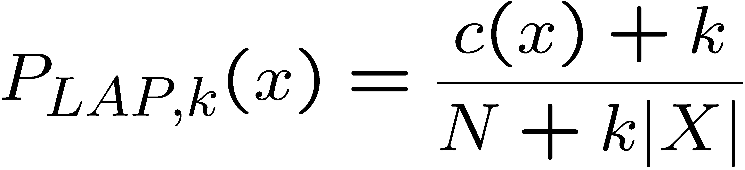
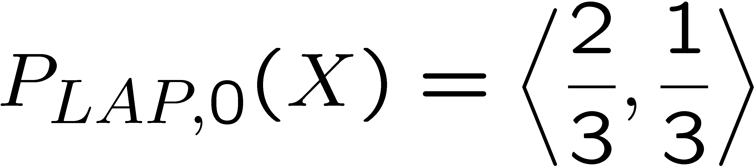
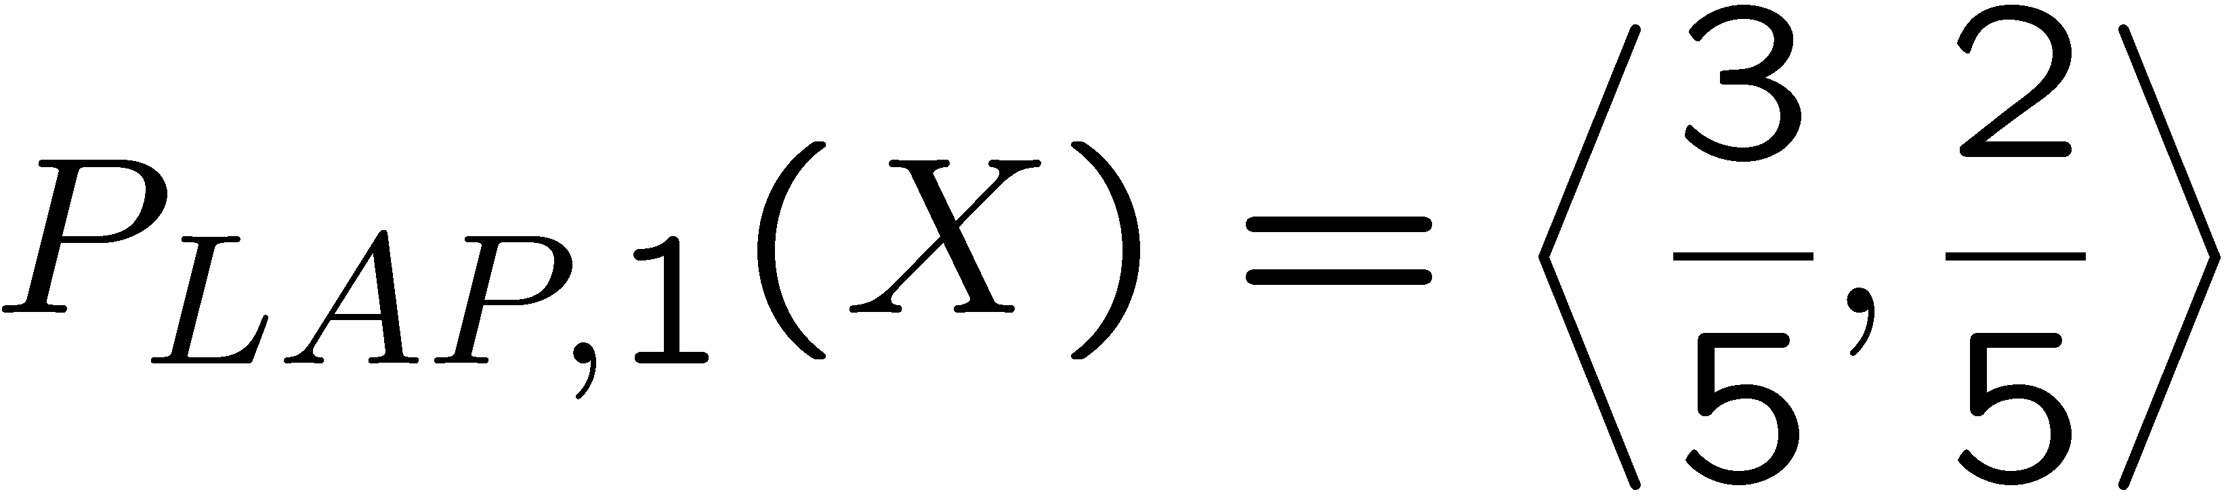
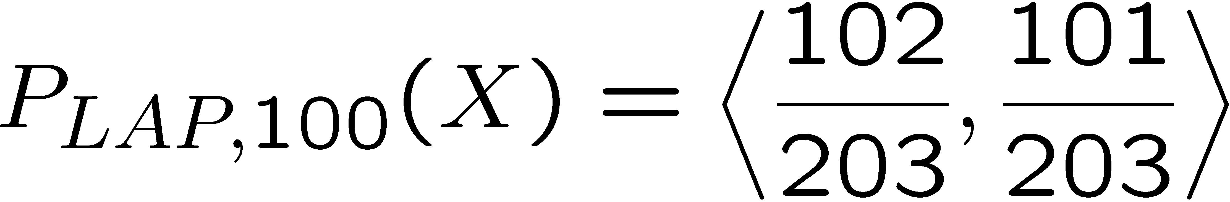
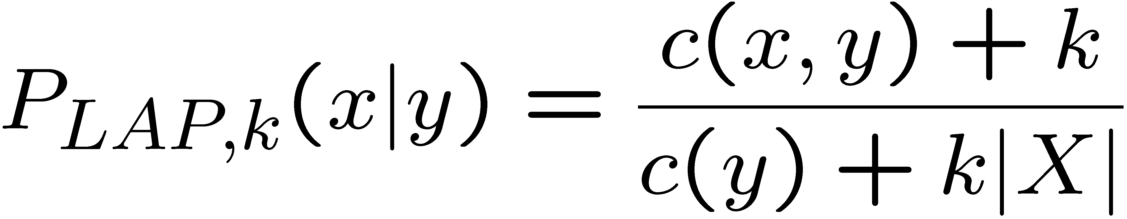
Laplace Smoothing
Laplace’s estimate (extended):
Pretend you saw every outcome k extra times
What’s Laplace with k = 0?
k is the strength of the prior
Laplace for conditionals:
Smooth each condition independently:
r
r
b

Slide 46
Real Naïve Bayes: Smoothing
For real classification problems, smoothing is critical
New odds ratios:
helvetica : 11.4
seems : 10.8
group : 10.2
ago : 8.4
areas : 8.3
...
verdana : 28.8
Credit : 28.4
ORDER : 27.2
<FONT> : 26.9
money : 26.5
...
Do these make more sense?

Slide 47
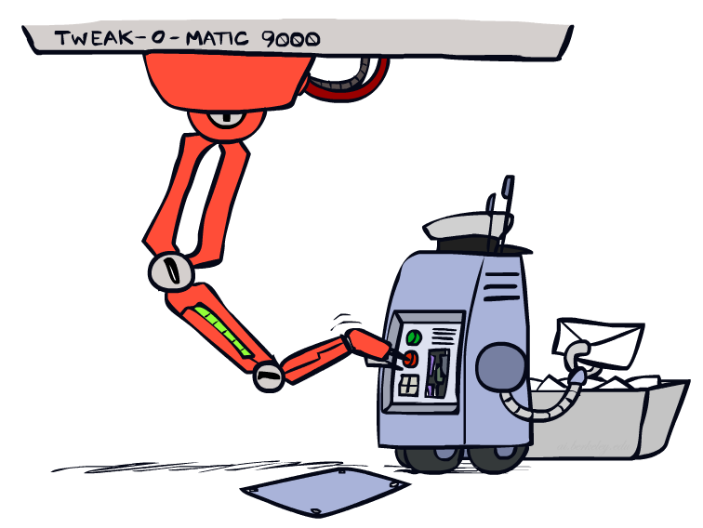
Tuning

Slide 48




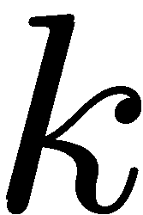



Tuning on Held-Out Data
Now we’ve got two kinds of unknowns
Parameters: the probabilities P(X|Y), P(Y)
Hyperparameters: e.g. the amount / type of smoothing to do, k, α
What should we learn where?
Learn parameters from training data
Tune hyperparameters on different data
Why?
For each value of the hyperparameters, train and test on the held-out data
Choose the best value and do a final test on the test data

Slide 49
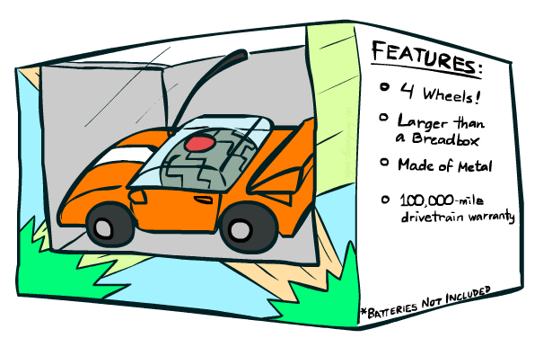
Features

Slide 50
Errors, and What to Do
Examples of errors
Dear GlobalSCAPE Customer,
GlobalSCAPE has partnered with ScanSoft to offer you the latest version of OmniPage Pro, for just $99.99* - the regular list price is $499! The most common question we've received about this offer is - Is this genuine? We would like to assure you that this offer is authorized by ScanSoft, is genuine and valid. You can get the . . .
. . . To receive your $30 Amazon.com promotional certificate, click through to
http://www.amazon.com/apparel
and see the prominent link for the $30 offer. All details are there. We hope you enjoyed receiving this message. However, if you'd rather not receive future e-mails announcing new store launches, please click . . .

Slide 51
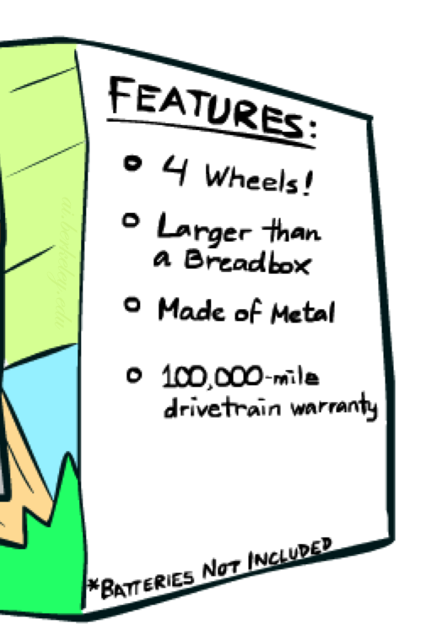
What to Do About Errors?
Need more features– words aren’t enough!
Have you emailed the sender before?
Have 1K other people just gotten the same email?
Is the sending information consistent?
Is the email in ALL CAPS?
Do inline URLs point where they say they point?
Does the email address you by (your) name?
Can add these information sources as new variables in the NB model
Next class we’ll talk about classifiers which let you easily add arbitrary features more easily, and, later, how to induce new features

Slide 52
Baselines
First step: get a baseline
Baselines are very simple “straw man” procedures
Help determine how hard the task is
Help know what a “good” accuracy is
Weak baseline: most frequent label classifier
Gives all test instances whatever label was most common in the training set
E.g. for spam filtering, might label everything as ham
Accuracy might be very high if the problem is skewed
E.g. calling everything “ham” gets 66%, so a classifier that gets 70% isn’t very good…
For real research, usually use previous work as a (strong) baseline

Slide 53
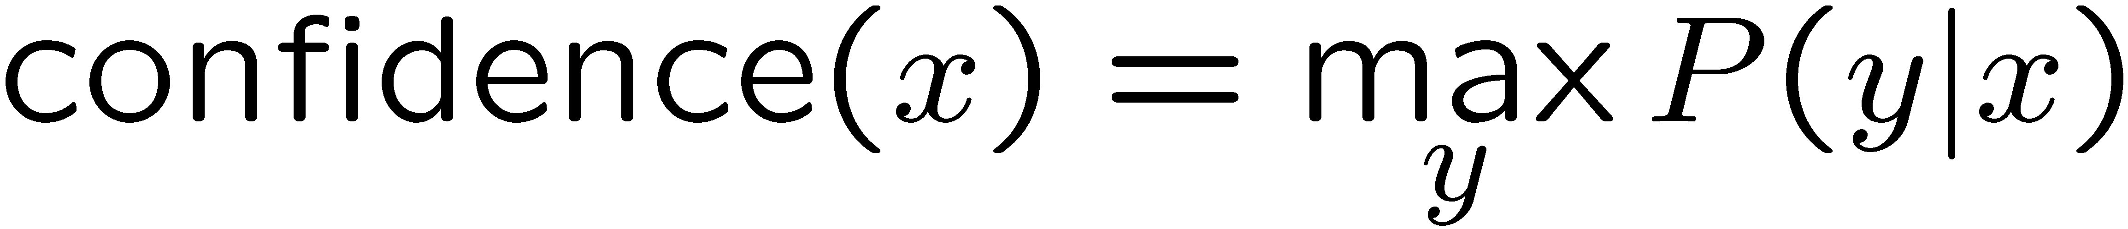

Confidences from a Classifier
The confidence of a probabilistic classifier:
Posterior probability of the top label
Represents how sure the classifier is of the classification
Any probabilistic model will have confidences
No guarantee confidence is correct
Calibration
Weak calibration: higher confidences mean higher accuracy
Strong calibration: confidence predicts accuracy rate
What’s the value of calibration?

Slide 54
Summary
Bayes rule lets us do diagnostic queries with causal probabilities
The naïve Bayes assumption takes all features to be independent given the class label
We can build classifiers out of a naïve Bayes model using training data
Smoothing estimates is important in real systems
Classifier confidences are useful, when you can get them

Slide 55
Next Time: Discriminative Learning

